Slide 1
Social Impacts Of Data Mining.
Group 23A21
Members :
Bhavesh sadhwani
Sagar Rokade
Abhay Prajapati

Slide 2
What is mining?
01
02
03
Data mining
data collection
data transformation
pattern evaluation
process of analysing large sets of data to uncover patterns, correlations, and insights
STEPS

Slide 3
Applications of data mining
Span Across various industries and fields
retail
customer behavior through trends and associations
finance
credit risk management, fraud detection
healthcare
identify individuals at high risk for specific diseases or health conditions

Slide 4
Why Data Mining?
Knowledge discovery: Data mining is used to discover hidden patterns, trends, and relationships within large datasets, which can help in generating new knowledge and insights.
Decision-making: Data mining assists in making informed and data-driven decisions by providing valuable information and insights derived from the analysis of complex datasets.
Forecasting and prediction: Data mining enables the identification of patterns and trends that can be used to forecast future trends, behaviors, and outcomes, helping organizations anticipate and plan for future scenarios.

Slide 5
Why Data Mining?
Improving business operations: Data mining helps organizations optimize their business processes, improve efficiency, reduce costs, and enhance overall performance through data-driven insights and recommendations.
Customer relationship management: Data mining aids in understanding customer behavior, preferences, and needs, enabling organizations to personalize their services and marketing strategies to improve customer satisfaction and loyalty.
Risk management: Data mining is utilized in identifying and mitigating risks in various domains, including finance, insurance, and healthcare, by analyzing historical data and predicting potential risks and vulnerabilities.

Slide 6
what are the steps of data mining?
Data collection
Exploratory data analysis
Gather relevant data
Conduct initial data analysis
Data preprocessing
Data mining
Clean and preprocess
Apply the chosen data mining algorithm
Data transformation
Transform the selected data

Slide 7
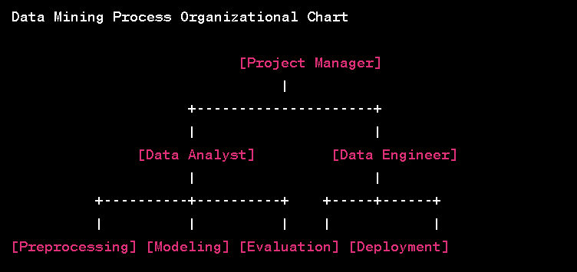

Slide 8
What Are The Benefits ?
Decision-making: Data mining helps businesses and organizations make informed and data-driven decisions by providing insights and patterns derived from large datasets.
Improved efficiency: By analyzing data, organizations can identify areas for improvement, streamline processes, and optimize operations, leading to increased efficiency and productivity.
Risk reduction: Data mining helps in identifying potential risks and vulnerabilities, enabling organizations to take proactive measures to mitigate risks and avoid potential pitfalls.

Slide 9
What Are The Benefits ?
Cost reduction: By optimizing operations, streamlining processes, and improving decision-making, data mining can lead to cost savings and resource optimization for organizations.
Competitive advantage: Leveraging data mining allows businesses to stay ahead of competitors by identifying market trends, consumer behavior, and emerging patterns, enabling them to make strategic decisions to gain a competitive edge.
Targeted marketing and sales: Data mining enables organizations to target specific customer segments with personalized marketing strategies, leading to increased sales and improved marketing ROI.

Slide 10
Are There Any Demerits ?
High costs and complexity: Implementing data mining processes can be expensive and complex, requiring specialized skills, advanced technology, and substantial computational resources.
Overreliance on technology: Overreliance on data mining technology and algorithms can lead to a lack of human intuition and judgment, potentially limiting the exploration of alternative perspectives and creative problem-solving approaches.
Data overfitting: Data mining models may overfit the training data, leading to poor generalization and performance on new, unseen data, which can impact the reliability and effectiveness of the models in practical applications.

Slide 11
Misconceptions regarding data mining
Privacy concerns: Data mining often involves the collection and analysis of personal data, raising concerns about privacy and the potential misuse of sensitive information.
Ethical considerations: The use of data mining raises ethical concerns, including the responsible handling of personal data, transparency in data collection practices, and the need for informed consent.
Security risks: Storing and analyzing large datasets for data mining purposes can expose sensitive information to security threats and breaches, leading to data leaks and potential security risks.

Slide 12
Misconceptions regarding data mining
Misinterpretation of results: Data mining results can be complex and may be misinterpreted without a proper understanding of the context and data, leading to flawed decision-making and implementation.
Legal and regulatory compliance: Data mining activities must comply with various legal and regulatory requirements, such as data protection laws and regulations, which can pose challenges for organizations.
Bias and discrimination: Data mining can perpetuate societal biases if the datasets used for analysis are not diverse and representative, leading to discriminatory practices in various domains, including employment, housing, and lending.

Slide 13
Conclusion :
Data mining has significant social impacts, both positive and negative
Improved Healthcare Services
Enhanced Public Safety and Security
Increased Efficiency in Governance
Invasion of Privacy
Ethical Concerns
Bias and Discrimination

